Slide 1
Раковые стволовые клетки: происхождение, метастазирование и реакция на облучение
Cancer stem cells:
origin, metastasis,
and response to radiation
Nadya Morozova
(CNRS, France)

Slide 2
Current dogma:
Cancer stem cells are responsable for tumor relapse
after the radiotherapy treatment

Slide 3
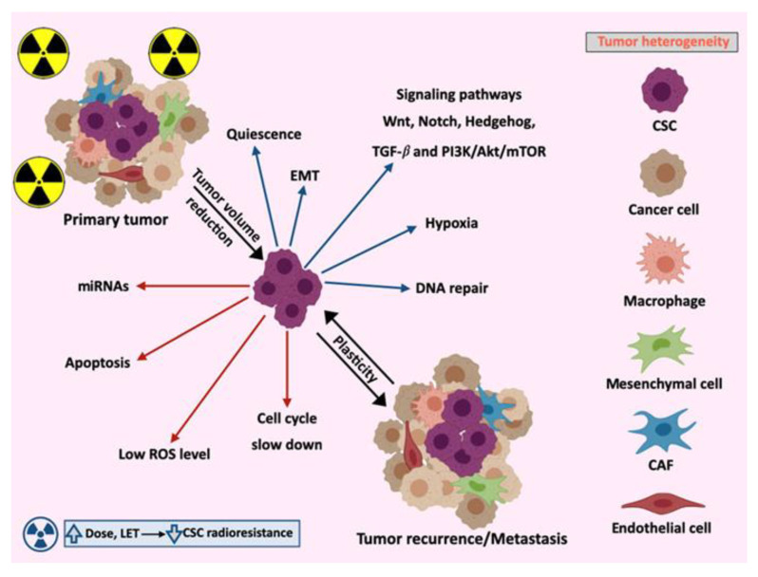
Non-stem cancer cells are more vulnerable to radiation.
Radiation kills most of non-stem cancer cells,
while cancer stem cells survive and repopulate the tumor

Slide 4
Why cancer stem cells are more resistant to radiation?
Quiescent (slow-dividing) state,
less susceptible to radiation.
Enhanced DNA repair mechanisms,
recovering from radiation-induced DNA damage
High levels of anti-apoptotic proteins
More reactive oxygen species (ROS) scavengers
(Glutathione (GSH),Vitamin C (ascorbic acid),Vitamin E),
better survive oxidative stress from radiation.

Slide 5
Modern strategies in radiotherapy
Sensitizing CSCs (e.g., targeting their DNA repair pathways)
Combining radiation with drugs that eliminate or inhibit CSCs

Slide 6
1 Gy (Gray) = 1 joule of radiation energy
absorbed per kilogram of tissue
Modern radiation techniques commonly use
a dose of 10 Gy
for radiation therapy of tumors
Fractionated radiation exposer:
2Gy, 4Gy, 6Gy, 8Gy, 10Gy

Slide 7
Cancer Stem cells (CSC) =
“Tumor Initiating Cells” (TIC)
1-5% of total cancer cell population
High ability to initiate tumor growth
It was reported that some characteristics of tumor initiating cells
are similar to normal stem cells

Slide 8
Stem Cells
Stem Cell=Pluripotent Cell
Pluripotency- the ability of a cell to produce
many differentiated cell types of adult organism
1.Embryonic stem cells
2. Adult stem cells
3.Cancer stem cells
normal
cancer

Slide 9
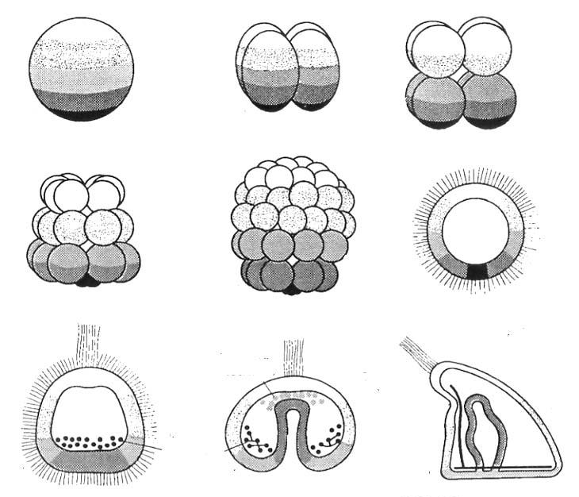
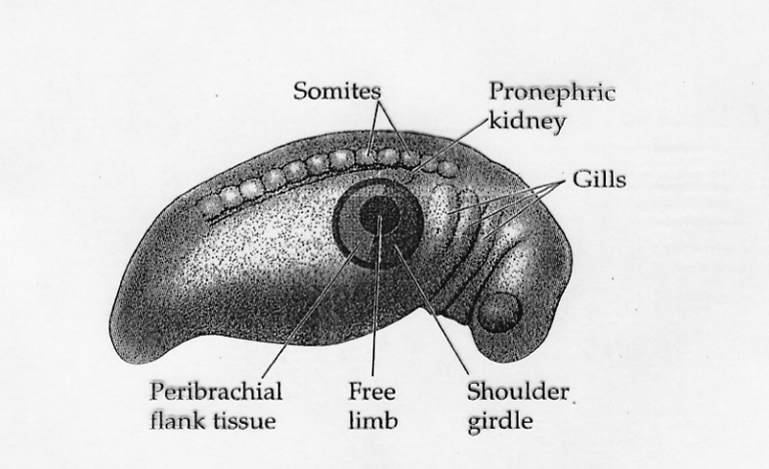

Development of an animal organism
Zygote
Embryo
Adult organism
Adult
stem cells
Embryonic
stem cells
?
dedifferentiation
Totipotent
cell
Pluripotent
cell
Bipotent
cell
Differentiated
cell

Slide 10
Main characteristics of Normal Adult Stem Cells
- ability to regenerate a tissue
- small percentage in total cell population
slow rate of cell division
- asymmetric cell division
with ability to self-renewing
D
D
S
unlike
D
S
D
stem cell
differentiated cell
(non-stem)

Slide 11
Cancer Stem cells (TIC)
-ability to regenerate all cancer population
-small percentage in total cancer cell population
-asymmetric cell division - ??
-slow rate of cell division - ??

Slide 12
Cancer stem cells and normal stem cells –
more similarity or more differences?

Slide 13
Do cancer stem cells originate from normal stem cells ?
Or they appear due to non-stem to stem cell transition?

Slide 14
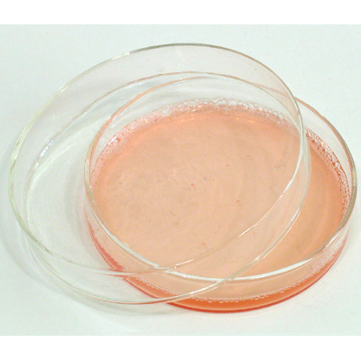
Cancer cell culture
Cancer cell culture starts from a tumor taken from a patient
Cancer stem cells can be identified according to specific
Molecular Marker (CD133, CD10, CD44/CD24, etc.)
Cancer stem cells can be sorted according to this
Molecular Marker by FACS analysis

Slide 15
Phenomenon
of Cancer Stem Cells population
stabilization in cell culture
The percentage
of Cancer Stem Cells population
is characteristic for each cancer cell line

Slide 16
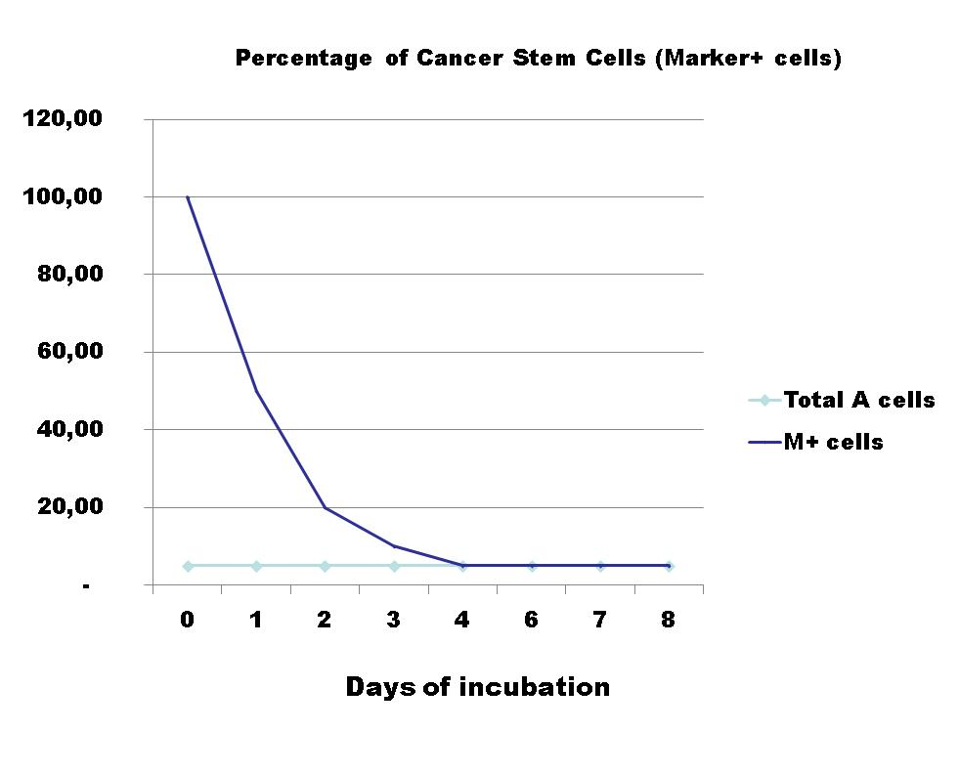
Phenomenon: stabilization of Cancer Stem Cells population
in cell culture
after perturbation
pure (100%) stem cells population
in Total cancer cell
population
in purified CSC
population
- characteristic % for each cell line
was shown in lung, ovarian, colon, breast cancer cell lines

Slide 17
Cancer Stem Cells and Epithelial-Mesenchymal Transition (EMT)

Slide 18
Epithelial–Mesenchymal Transition
is a developmental program
in which epithelial cells
transform into mesenchymal cells
epithelial cells mesenchymal cells
polarized motile
tightly attached invasive
organized in sheets poor connected
EMT is necessary for normal embryogenesis

Slide 19
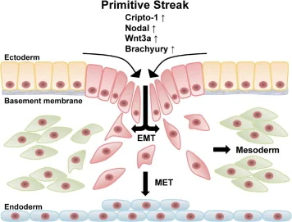
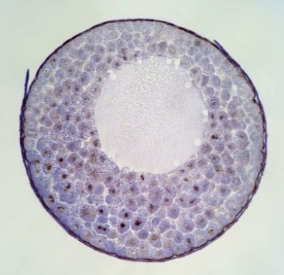
EMT in normal development
EMT Cell migration Formation of new germ layers
Ectoderm
Mesoderm
Endoderm
gastrulation
Blastula
MET (Mesenchymal–Epithelial Transition) → tissue and organ formation

Slide 20
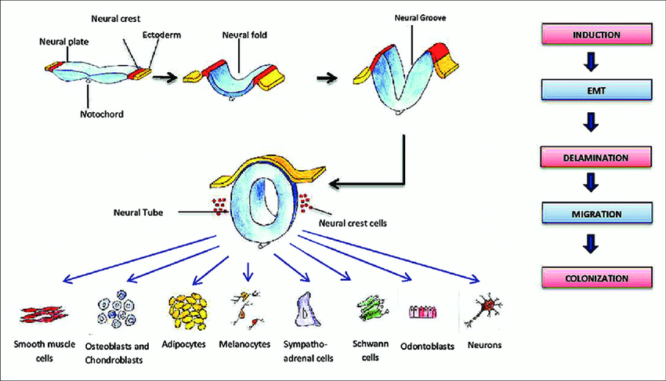
Neural crest cell migration
EMT → cell migrate → settle → re-epithelialize → MET → organ formation

Slide 21
During EMT cells
Undergo morphological change
-> Loose apico-basal polarity
-> Remodel cytoskeleton
Gain migratory ability
-> Dissolve tight junctions
-> Loose cell-cell contacts
Downregulate epithelial markers
E-cadherin
Upregulate mesenchymal markers
N-cadherin, Vimentin

Slide 22
Mesenchymal cells
Key signaling pathways:
TGF-β
Wnt
FGF
BMP
Key transcription factors:
Snail
Slug
Twist
Zeb1/2

Slide 23
Cancer stem cells and EMT
a
Cancer hijacks a normal embryonic program
Embryonic EMT
Organ formation
Precisely controlled
Temporally restricted
Cancer EMT
Metastasis
Dysregulated
Not restricted
Purpose
Regulation
Timing

Slide 24
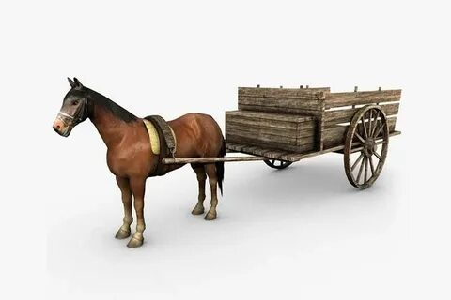

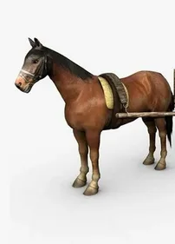
Cancer stem cells and EMT ?
EMT
CSC
EMT
CSC

Slide 25
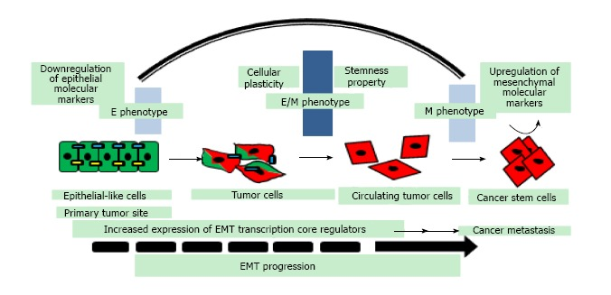
EMT → M phenotype → CSC
Cancer stem cells and EMT
1
Cancer cells acquire CSC properties by EMT

Slide 26
Mani et al., 2008:
Inducing EMT in cancer cells create cells with CSC properties

Slide 27
Cancer stem cells and EMT
2
Epithelial-mesenchymal transition and metastasis
CSC at primary tumor site → EMT →
→ migration →new location →
→ MET → start of metastatic tumor growth

Slide 28
Cancer stem cells, EMT and metastasis.
Cancer stem cells with hybrid E/M phenotype (partial EMT)
gain self-renewability, migratory and invasive traits
during cancer metastasis.

Slide 29
I. Zamulaeva et al., 2019;2021;2023
MRRC
Increase in CSC population after irradiation
- switch from asymmetric to symmetric type of division
- reprogramming of non-stem cancer cells to CSC
Correlations between Vimentin expression(EMT)
and post-radiation increase in CSC numbers
The proportion of CSC before irradiation
did not have prognostic significance.
Bad prognostic is determined by an
increase in CSC population after irradiation

Slide 30
Contradictions and Concerns
Contribution of EMT to post-radiation
increase of CSC??
IZ: During fractionated radiation:
increase of CSC - after 2Gy
increase of Vimentin –after 4-6 Gy
2. Many data claim:
Vimentin increase → bad clinical outcome
Inhibitors of EMT → good clinical prognosis
IZ: Vimentin increase → bad clinical outcome??
3. Non-CSC → CSC switch via EMT??

Slide 31
Possible response ?
Both EMT and CSC independently
cause resistance to radiotherapy
Quiescence
DNA damage repair
Anti-apoptotic signaling
ROS scavengers

Slide 32
CSC and cancer response to irradiation

Slide 33
Investigation of the relapse
of breast cancer after irradiation
Cancer stem cells are responsable for tumor repopulation?
What scenarios of cell behavior
are responsible for cancer relapse?

Slide 34
Mathematical Modeling
given an experimentally measured curves
of post-irradiation dynamics
of cancer stem and non-stem cells
find out all scenarios of cells behavior

Slide 35
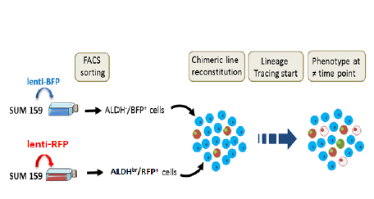
Breast cancer chimeric cells
Breast cancer cell line SUM 159
ALDH+ marker for stemness
Lineage tracing assay
X-rays
10Gy
non-stem cells
measurements of
cell populations kinetics
stem cells
X-rays
10Gy
iCSC
Blue cells – of non-stem origine
Red cells – of stem origin
C. Ginestier, CNRS, Marseille

Slide 36
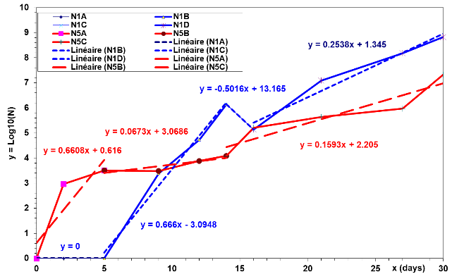
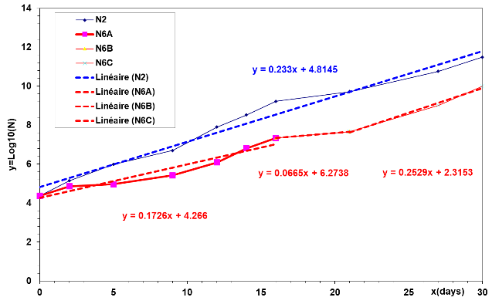
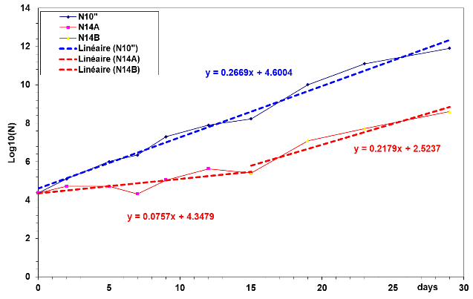
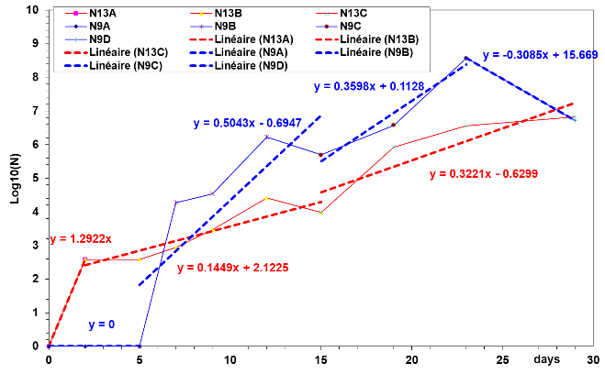
Experimental data:
Kinetics of Stem(S) and non-Stem (D) cells after irradiation
initially all stem-negative cells
Stem-positive (S)
Stem-negative (D)
Control
Control
Irradiated
Irradiated
Irradiated
Control
initially all stem-positive cells
Stem-positive (S)
Stem-negative (D)
Control
Control
Control
Irradiated
Irradiated
Irradiated

Slide 37
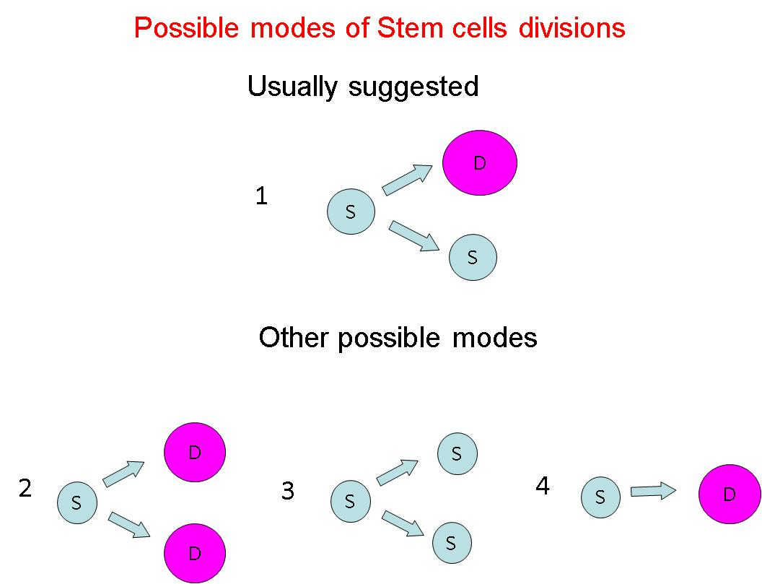
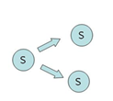
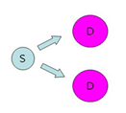
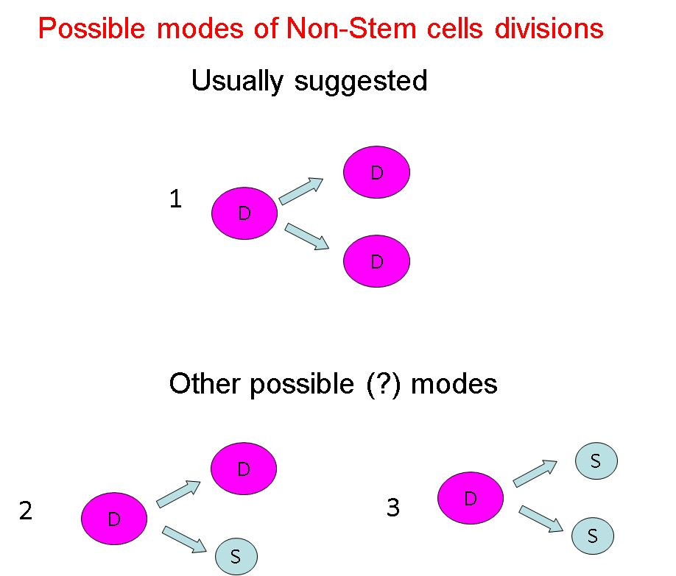
Possible scenarios of Stem Cells Behavior
Possible scenarios of Non-Stem Cells Behavior
Other possible modes
4
D
S

Slide 38
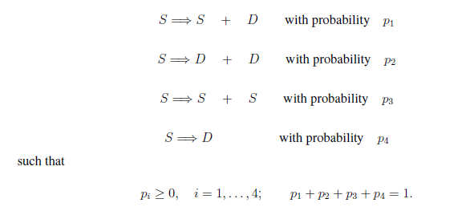
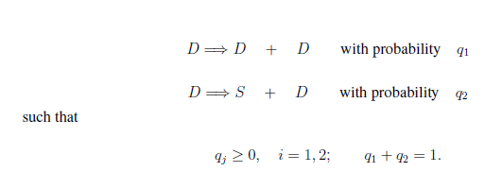
Stem cells
Daughter cells

Slide 39
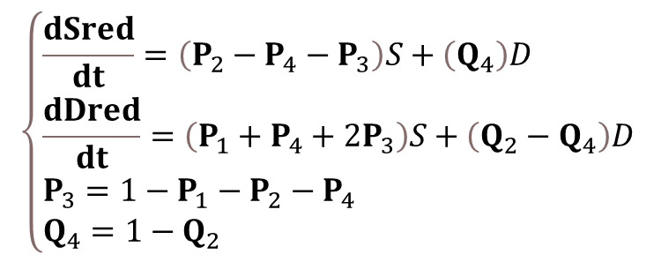
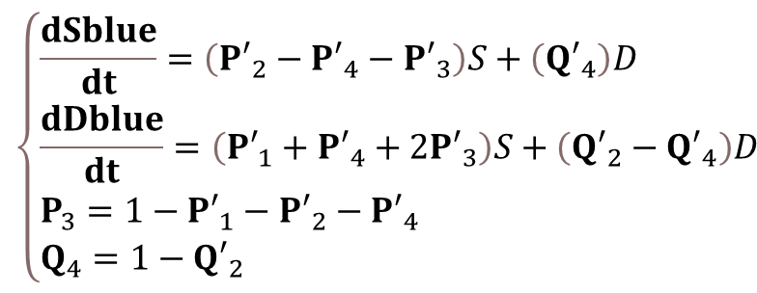
2 systems of equations
$$\left\{\begin{aligned}&\frac{dSred}{dt}=\left(P_{2}−P_{4}−P_{3}\right)S+\left(Q_{4}\right)D \\ &\frac{dDred}{dt}=\left(P_{1}+P_{4}+{2P}_{3}\right)S+\left(Q_{2}−Q_{4}\right)D \\ &P_{3}=1−P_{1}−P_{2}−P_{4} \\ &Q_{4}=1−Q_{2}\end{aligned}\right.$$
$$\left\{\begin{aligned}&\frac{dSblue}{dt}=\left({P′}_{2}−{P′}_{4}−{P′}_{3}\right)S+\left({Q′}_{4}\right)D \\ &\frac{dDblue}{dt}=\left({P′}_{1}+{P′}_{4}+{2P′}_{3}\right)S+\left({Q′}_{2}−{Q′}_{4}\right)D \\ &P_{3}=1−{P′}_{1}−{P′}_{2}−{P′}_{4} \\ &Q_{4}=1−{Q′}_{2}\end{aligned}\right.$$
where probabilities of cell behavior P_{i}(t), Q_{i}(t) change with time
We perform a search for all sets of solutions pi(t), qi(t)
implementing experimental curves of cancer cells kinetics

Slide 40
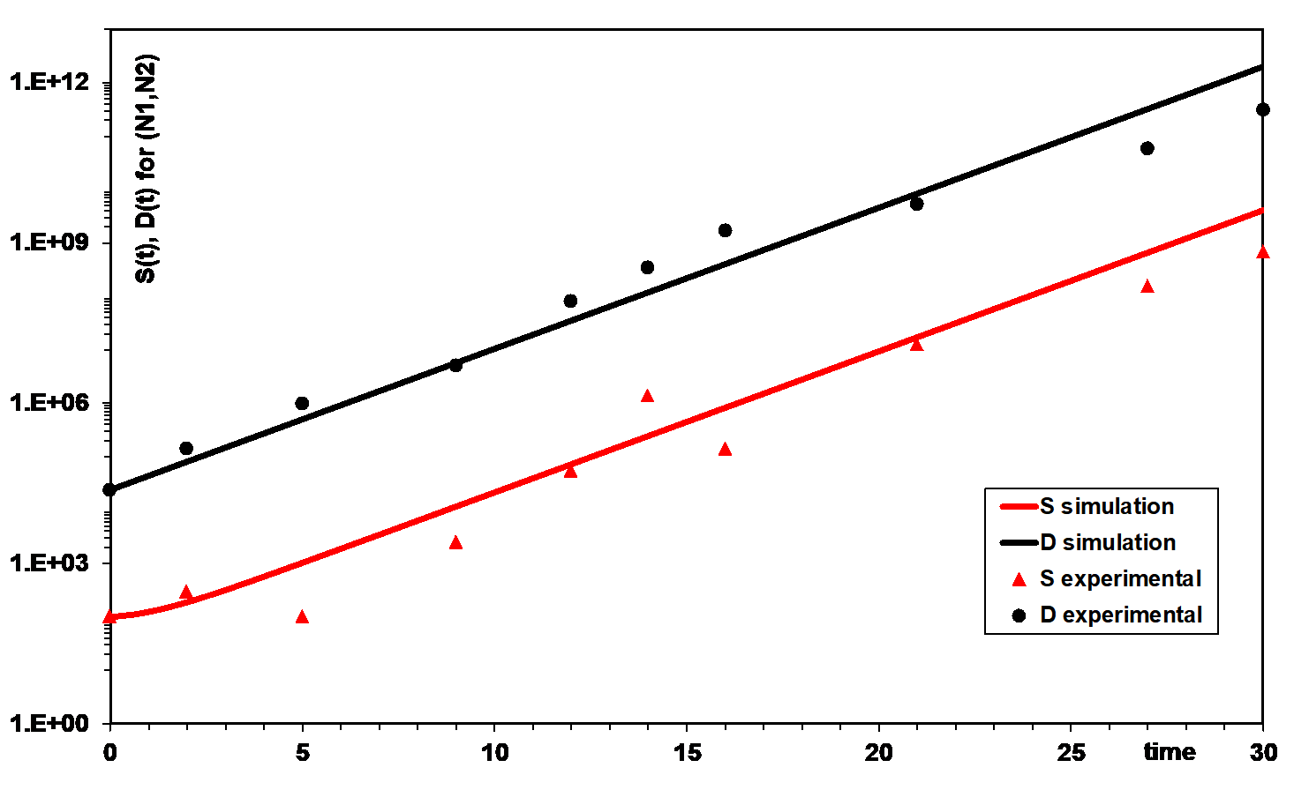
We perform a search for the solutions pi(t),qi(t)
which allow the model satisfying
the experimentally measured data
of stem and non-stem populations dynamics
For 4 systems of equations:
Blue cells - control and 10Gy
Red cells - control and 10Gy

Slide 41
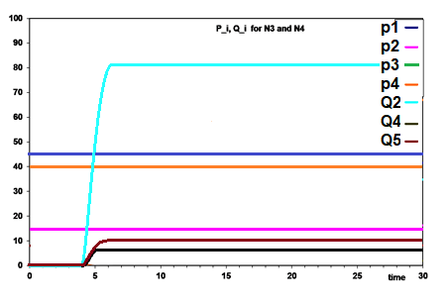
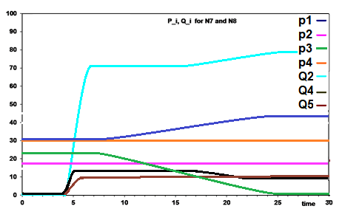
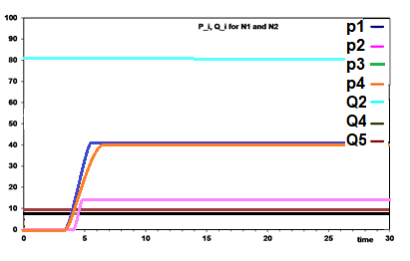
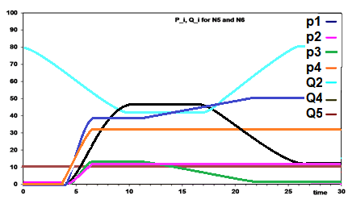
The evolution of probabilities pi(t), qi(t) obtained from numerical simulation
Red cells behavior
control
10Gy
Blue cells behavior

Slide 42
Computational tool (Software)
perform a search for all sets of scenarios of cell behavior
implementing an experimental curve s(t)
Input:
-Experimentally measured kinetics of cell population(s)
Experimentally measured rates of cell division/transition and cell death
Output:
-Proportions of possible scenarios of cell populations behavior (probabilities pi(t), qi(t))
Bessonov et al., Plos One, 2019

Slide 43
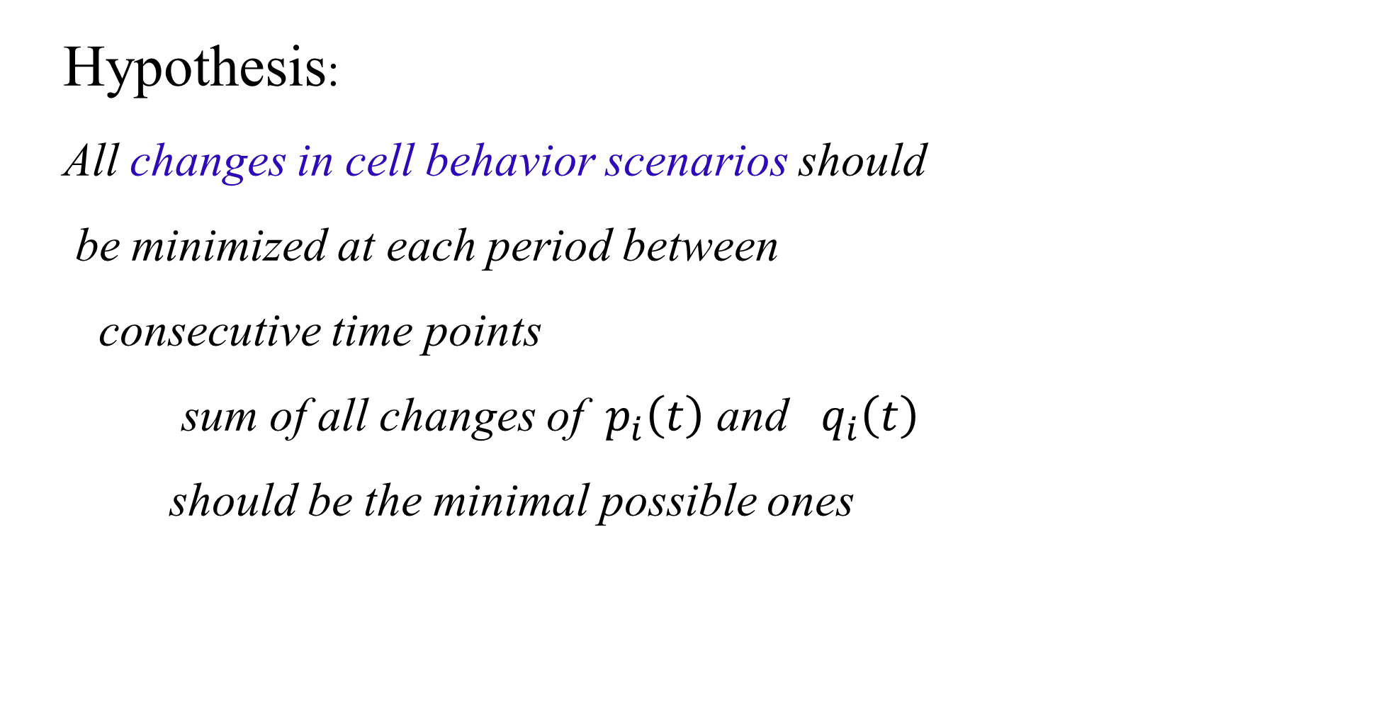
Corridors of probabilities pi(t), qi(t)
A
How to find 1 solution inside the corridor?
Hypothesis:
All changes in cell behavior scenarios should
be minimized at each period between
consecutive time points
sum of all changes of ${ p}_{i}\left(t\right)$ and $q_{i}\left(t\right)$
should be the minimal possible ones

Slide 44
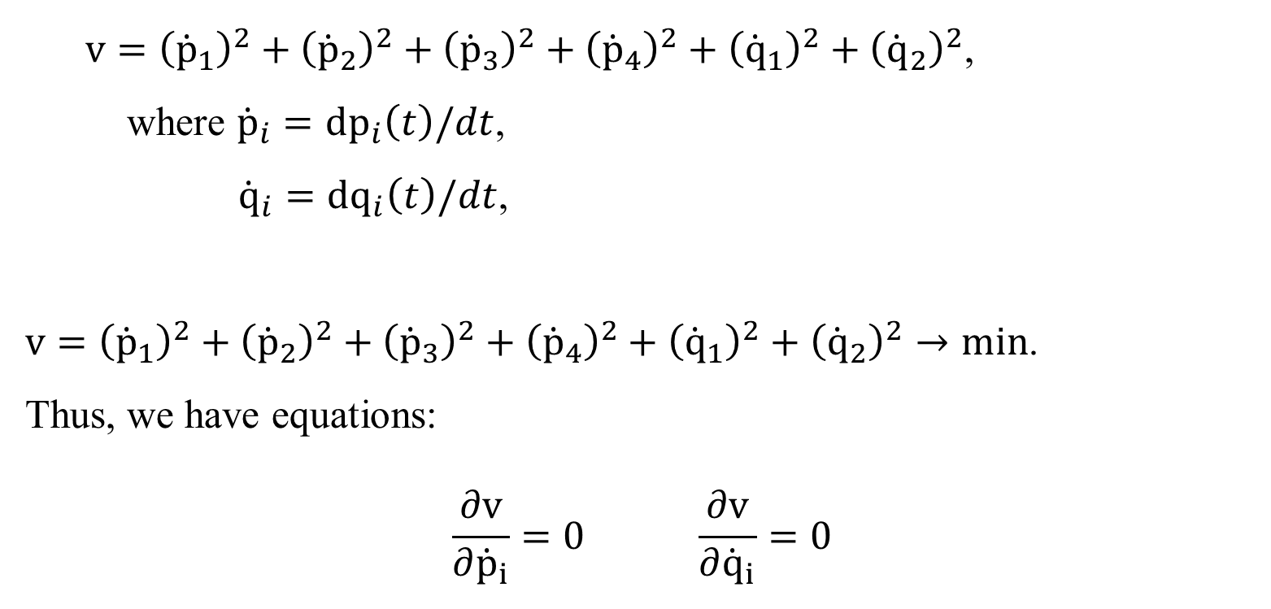
Corridors of probabilities pi(t), qi(t)
A
How to find 1 solution inside the corridor?
$v={\left({\dot{p}}_{1}\right)}^{2}+{\left({\dot{p}}_{2}\right)}^{2}+{\left({\dot{p}}_{3}\right)}^{2}+{\left({\dot{p}}_{4}\right)}^{2}+{\left({\dot{q}}_{1}\right)}^{2}+{\left({\dot{q}}_{2}\right)}^{2}$,
where ${{\dot{p}}_{i}=dp}_{i}\left(t\right)/dt$,
${{\dot{q}}_{i}=dq}_{i}\left(t\right)/dt$,
$v={\left({\dot{p}}_{1}\right)}^{2}+{\left({\dot{p}}_{2}\right)}^{2}+{\left({\dot{p}}_{3}\right)}^{2}+{\left({\dot{p}}_{4}\right)}^{2}+{\left({\dot{q}}_{1}\right)}^{2}+{\left({\dot{q}}_{2}\right)}^{2}→min$.
Thus, we have equations:
$$\frac{∂v}{∂{\dot{p}}_{i}}=0 \frac{∂v}{∂{\dot{q}}_{i}}=0$$

Slide 45
The evolution of probabilities pi(t), qi(t) obtained from numerical simulation
Red cells behavior
control
10Gy
Blue cells behavior

Slide 46
Main conclusion:
Irradiation changes the probability of transition from non-stem to stem cells
This can be the main reason of tumor relapse
in breast cancer

Slide 47
To take away questions
How do cancer stem cells originate ?
How CSC and EMT are connected?
What is/are the reason(s) of cancer relapse after irradiation?
?

Slide 48
Acknowledgements
Biologists:
CNRS, Paris:
A. Harel-Bellan
G. Pinna
G. Kratassiouk
CNRS, Marseille:
C. Ginestier
E. Charafe
Mathematicians:
University of Milano, Italy:
V. Capasso
IPME, SPb, Russia:
N. Bessonov
Special Acknowledgements
I. Zamulaeva MRRC, Russia

