Slide 1




XXV международная молодежная научная школа имени А.С. Саенко
«Современные проблемы радиобиологии»
Обнинск, 18-22 мая 2026
Non-linear mixed effect modeling in pharmacokinetic evaluation. Relevance during the application of combined therapies
including radiotherapy
Ignacio Hernández González
Laboratory of Radiation Biology, JINR, ignacio@jinr.cu
Non-Clinical Research Department, CENTIS

Slide 2
Content:
What pharmacometrics is about?
Components of pharmacometrics.
Pharmacokinetic and pharmacodynamics as the base of pharmacometrics applications.
Non lineal mixed effect models, the population approach.
Experimental design.
Examples in application of combined therapies.
  Experimental
  Clinical

Slide 3
What PHARMACOMETRICS is about?
Pharmacometrics is the science of interpreting and describing pharmacology in a quantitative fashion.
Pharmacometrics: The Science of Quantitative Pharmacology
Ene I. Ette, Paul J. Williams (eds),
2007, John Wiley & Sons, Inc.

Slide 4
Components of pharmacometrics.
Discipline | Role in Pharmacometrics
Pharmacology (PK/PD) | This is the biological core of the science. Pharmacokinetics (PK) models how the body acts on a drug over time. Pharmacodynamics (PD) models how the drug acts on the body, relating concentration to effect.
Mathematics & Statistics | The essential quantitative "engine". Statistics, especially population analysis (NLMEM), deals with data variability and is crucial for separating true drug effects from random noise.
Physiology & Medicine | These provide the real-world context and biological constraints for models, ensuring they remain plausible. Disease progression modeling is a key output, aiming to describe the time course of a disease and its modification by treatment.

Slide 5
Components of pharmacometrics.
Discipline | Role in Pharmacometrics
Engineering & Computer Science | These translate theory into practice. Engineering contributes concepts from control theory and systems thinking. Computer science provides the programming skills and software (e.g., R, NONMEM, Monolix) necessary to implement complex models.
Related Emerging Fields | Quantitative Systems Pharmacology (QSP) merges pharmacometrics with systems biology to model complex biological networks. Machine Learning (ML) and Artificial Intelligence (AI) Pharmacometrics Data Programming (PMxP) for managing complex data workflows.
Radiation phisics DOSIMETRY

Slide 6
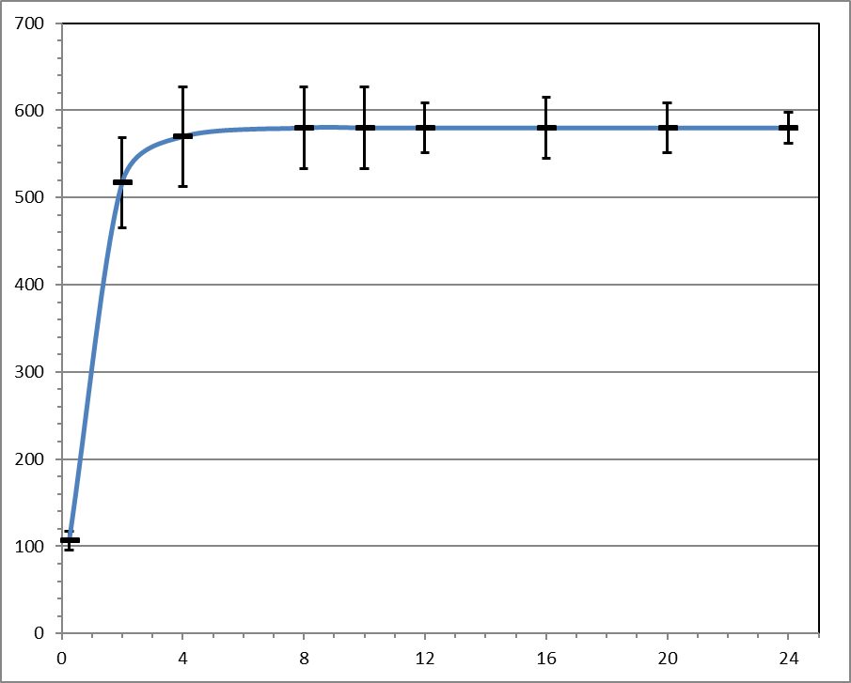
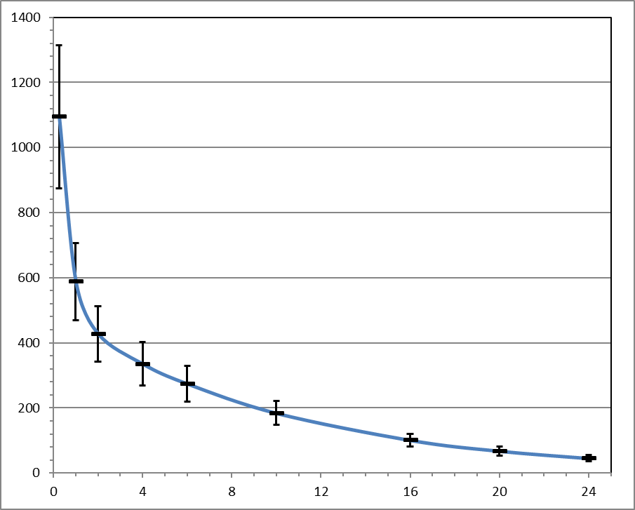
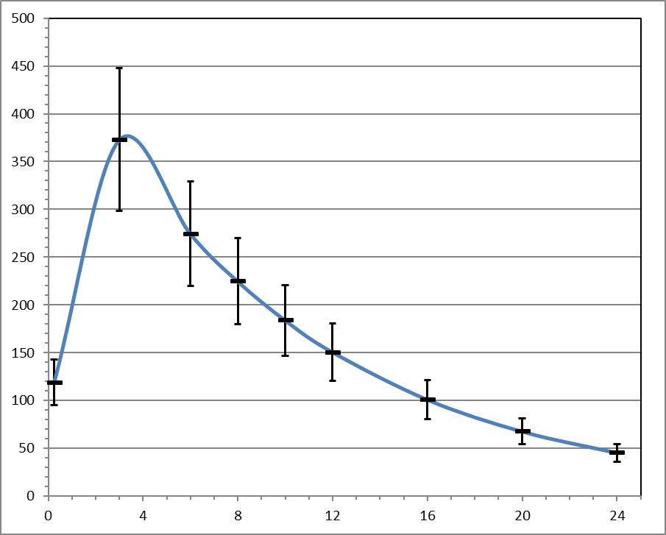
Pharmacokinetic.
Absorption
Distribution
Time variations of concentration changes
Metabolism
Excretion
Curiosity:
Dost F H (1953) Der Blutspiegel-kinetic der Konzentrationsablaufe in der Krieslauffussigkeit. G. Thieme, Leipzig
Nelson E (1961) Kinetics of Drug Absorption, Distribution, Metabolism and Excretion. J Pharm Sci 50: 181-192

Slide 7
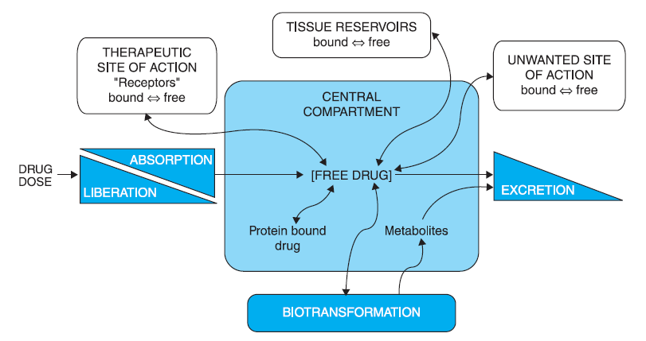
Pharmacokinetic.

Slide 8
Pharmacodynamic.
Mechanisms of action
Chemical structure
Biological activity
Enhancing the desired effects
Reduce adverse effects

Slide 9

Sampling and analysis strategies in pharmacokinetic
Extensive sampling
  «Dense data» and traditional two step approach
Sparse data
  Reduced number of subject
  Reduced number of samples
Data analysis depend on experimental design

Slide 10
Sampling and analysis strategies
Snapshot PK & Fast PK
  Non clinical PK
  Very reduced number of animals
  Very useful in screening of potential drugs
Fast PK | Sampling time
No. Animal | t1 | t2 | t3 | t4 | t5 | t6 | t7 | t8
1 | ● |  | ● |  | ● |  | ●
2 |  | ● |  | ● |  | ● |  | ●
Snapshot PK | Sampling time
No. Animal | t1 |  | t2 |  | t3 |  | t4
1 | ● |  | ● |  | ● |  | ●
2 | ● |  | ● |  | ● |  | ●
Liu B, Chang J, Gordon W P, et al. 2008 Drug Discovery Today 13, 360-367.
Reddy J, Madishetti S, Vachaspati P R, 2012 Eur Jpharm Sci 47, 444–450

Slide 11
Sampling and analysis strategies in pharmacokinetic
Naive pooled data*
  Used in destructive sampling
  Average as single individual
  Consider no data/model structure
  Ignore inter & intra individual variability
  Poor performance
  Use large number of subject
*Sheiner, L.B. and Beal, S.L. J Pharmac & Pharm 1980, 8, 553-571.

Slide 12
Sampling and analysis strategies in pharmacokinetic
Two step approach
It solves many of the experimental and clinical situations.
It has a wide range of computer tools for its application.
In addition, it is relatively simple to implement it with prop tools

Slide 13
Sampling and analysis strategies in pharmacokinetic
Two step approach
  Only in the case of dense data
  Large number of subject
  Erroneous estimation of variability
MEASURED VARIABLE
≠
DESCRIPTIVE PARAMETER
PRECISION MEASUREMENT
≠
BYASED ESTIMATION
Parameter estimation error ≠ Inter individual variability
Wright P M C. Br J Clin Pharmacol 1998, 64:5 603–612.

Slide 14
Sampling and analysis strategies in pharmacokinetic
Two step approach
The additional imprecision arises in the estimation procedure itself.
The inaccuracy contained in the mean and standard deviation of the pharmacokinetic parameter drags the inaccuracy already contained in each individual estimate and both inaccuracies cannot be separated.
The error in the estimation of the parameter is confused with the variability of that parameter between individuals

Slide 15
Defining Population Pharmacokinetic
Population pharmacokinetics can be defined as the study of the variability in plasma drug concentrations between individuals when standard dosage regimens are administered. It is of interest both to measure this variability within the population and to account for it in terms of patient variables, such as age, sex, weight or disease state.
AARONS L, Population pharmacokinetics: theory and practice.
Br. J. Clin. Pharmac. 1991, 32, 669-670

Slide 16
Defining Population Pharmacokinetic
Hierarquical model:
Individual observations
Individual observations
Random effect
Probability distribution
Probability distribution
Individual parameters
Individual variability
Non Lineal Mixed Effect Models

Slide 17
Defining Population Pharmacokinetic
Adition of covariates!!
Qualitative
Quantitative
Nominal
Ordinal
Continuous
Discrets
Sex (M, F)
Response level
Weigh
Number of events

Slide 18
Recommendation.
RECOMENDED!

Slide 19
Application of population approach.
Sparse data application in population pharmacokinetic
  Non clinical and clinical PK
  Special subject population
  Ethical need in non clinical research (3Rs)
  Practical need

Slide 20
Design performance of sparse data appication.
No overlapping (NOVL)
Group | ID | 1 min | 0.25h | 0.5h | 1h | 2h | 4h | 8h | 12h | 24h
1 | 1 | • | • | •
 | 2 | • | • | •
 | 3 | • | • | •
2 | 4 |  |  |  | • | • | •
 | 5 |  |  |  | • | • | •
 | 6 |  |  |  | • | • | •
3 | 7 |  |  |  |  |  |  | • | • | •
 | 8 |  |  |  |  |  |  | • | • | •
 | 9 |  |  |  |  |  |  | • | • | •
Overlapping (OVL)
Group | ID | 1 min | 0.25h | 0.5h | 1h | 2h | 4h | 8h | 12h | 24h
1 | 1 | • |  | • |  |  | •
 | 2 | • |  | • |  |  | •
 | 3 | • |  | • |  |  | •
2 | 4 |  | • |  | • |  |  | •
 | 5 |  | • |  | • |  |  | •
 | 6 |  | • |  | • |  |  | •
3 | 7 |  |  |  |  | • |  |  | • | •
 | 8 |  |  |  |  | • |  |  | • | •
 | 9 |  |  |  |  | • |  |  | • | •

Slide 21
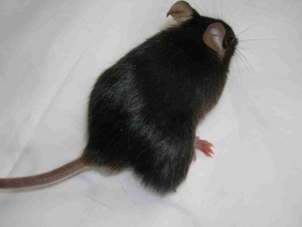
Design performance of sparse data appication.
Design considerations:
Mice: 22g body weight
Blood volume: 1.5 mL*
Maximum sample volume: 70 uL
No. of serial samples/animal: 3
Maximum % of blood volume: 13%
* Brown RP, et al. Toxicology and Industrial Health 1997: 407-484

Slide 22

Design performance of sparse data appication.
Simulated data. Two compartment IV bolus administration. Sparse design with time points overlapped and no overlapped. Three and five samples per time point.
Tumor uptake model:
Encoded with MLXTran.
DESCRIPTION:
IV bolus with two compartments, tumor compartment
INPUT:
parameter={V, k, k12, k21, kt}
PK:
compartment(cmt=1, concentration=Cc, volume=V)
iv(cmt=1)
peripheral(k12, k21)
elimination(cmt=1, k)
compartment(cmt=3, amount=Ae)
transfer(from=1, to=3, kt)
OUTPUT:
output = {Cc, Ae}
Design comparison:
Wald test.
CV_{dif} = (CV₁-CV₂)/CV₂*100
_{IV}
T
k_{t}
B
k₁₂
P
k₂₁
MONOLIX
Lixoft, France
k_{e}
Hernandez I. PAGE 2014 (Population Approach Group in Europe) Meeting. Alicante, Spain.

Slide 23
Results. Desing performance. 3 samples per time point.
Fixed effects | Parameter | s.e. (lin) | r.s.e.(%) | p-value (Wald) | CVdiff
V_(CAT=novl*) | 1.54 | 0.049 | 3 | 0.65 | 0.00
V_(CAT=ovl ) | 1.51 | 0.047 | 3
k_(CAT=novl*) | 0.439 | 0.037 | 8 | 0.68 | 0.00
k_(CAT=ovl ) | 0.461 | 0.037 | 8
k12_(CAT=novl*) | 0.754 | 0.13 | 18 | 0.88 | 5.88
k12_(CAT=ovl ) | 0.782 | 0.13 | 17
k21_(CAT=novl*) | 0.919 | 0.27 | 29 | 0.99 | 11.54
k21_(CAT=ovl ) | 0.915 | 0.23 | 26
Random effects
omega_V,novl | 0.0447 | 0.026 | 57 |  | 18.75
omega_V,ovl | 0.0499 | 0.024 | 48
omega_k,novl | 0.0173 | 0.13 | 759 |  | 10.00
omega_k,ovl | 0.0157 | 0.11 | 690
omega_k12,novl | 0.18 | 0.1 | 56 |  | -22.22
omega_k12,ovl | 0.15 | 0.11 | 72
omega_k21,novl | 0.079 | 0.87 | 1100 |  | 252.56
omega_k21,ovl | 0.12 | 0.37 | 312
Large error in random effect estimation
Hernandez I. PAGE 2014 (Population Approach Group in Europe) Meeting. Alicante, Spain.

Slide 24
Results. Desing performance. 5 samples per time point.
Fixed effects | Parameter | s.e. (lin) | r.s.e.(%) | p-value (Wald) | CVdiff
V_(CAT=novl*) | 1.23 | 0.19 | 15 | 0.71 | 50.0
V_(CAT=ovl ) | 1.15 | 0.11 | 10
k_(CAT=novl*) | 0.576 | 0.13 | 23 | 0.74 | 130.0
k_(CAT=ovl ) | 0.625 | 0.064 | 10
k12_(CAT=novl*) | 1.57 | 0.33 | 21 | 0.79 | 23.5
k12_(CAT=ovl ) | 1.69 | 0.29 | 17
k21_(CAT=novl*) | 2.31 | 0.63 | 27 | 0.64 | 80.0
k21_(CAT=ovl ) | 1.99 | 0.29 | 15
Random effects
omega_V,novl | 0.496 | 0.11 | 23 |  | 9.5
omega_V,ovl | 0.329 | 0.07 | 21
omega_k,novl | 0.43 | 0.098 | 23 |  | 4.5
omega_k,ovl | 0.206 | 0.045 | 22
omega_k12,novl | 1.1 | 0.28 | 26 |  | -3.7
omega_k12,ovl | 0.792 | 0.21 | 27
omega_k21,novl | 2.07 | 0.47 | 23 |  | 0.0
omega_k21,ovl | 0.889 | 0.21 | 23
Better estimation
of random effect
Better estimation
in OVL
Hernandez I. PAGE 2014 (Population Approach Group in Europe) Meeting. Alicante, Spain.

Slide 25
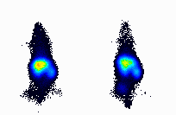
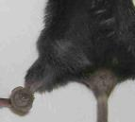
Example of sampling strategy applied to radiolabeled molecule
Group | Animal | Sampling time
 |  | 1min | 1h | 8h | 12h | 24h | 48h
1 | 1 | X |  | X |  | X
 | 2 | X |  | X |  | X
 | 3 | X |  | X |  | X
2 | 4 | X | X |  | X |  | X
 | 5 | X | X |  | X |  | X
 | 6 | X | X |  | X |  | X
X | Blood sample & imaging
 | Euthanasia & dissection

Slide 26
Example of sampling strategy applied to radiolabeled molecule
Group | Animal | Sampling time
 |  | 0* | 30 min | 1h | 4h | 8 h | 12 h | 24 h | 48 h
1 | 1 | X |  |  | X
 | 2 | X |  |  | X
 | 3 | X |  |  | X
2 | 4 |  | X |  |  | X |  | X
 | 5 |  | X |  |  | X |  | X
 | 6 |  | X |  |  | X |  | X
3 | 7 | X |  | X |  |  | X |  | X
 | 8 | X |  | X |  |  | X |  | X
 | 9 | X |  | X |  |  | X |  | X
X | Blood sample & imaging
 | Euthanasia & dissection

Slide 27
Results. Desing performance. 3 samples per time point.
Graph results of simulated tumor model data.
blood
tumor

Slide 28
Application of pharmacometrics in combined therapy

Slide 29
Why therapy combination?
Increase efficacy by achieving SINERGY
1 + 1 > 2 means life
Easier to say tan to prove
Verpoorte R., Kim H.K., Choi Y.H. Synergy: Easier to say than to prove. Synergy 7 (2018) 34–35

Slide 30
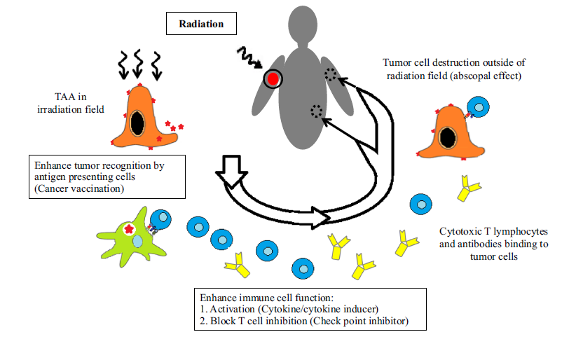
Rationales of combining radiation and immunotherapy.
Ishihara D., et al. Rationale and evidence to combine radiation therapy and immunotherapy for cancer treatment. Cancer Immunol Immunother (2017) 66:281–298

Slide 31
Why timing in combination therapy is critical?
Drugs and radiation affect dynamic biological processes:
DNA repair kinetics
Immune cell trafficking and activation
Cell cycle phase distribution
Mistimed combination can:
Kill the very immune cells needed for synergy
Induce resistance mechanisms (e.g., PD‑L1 upregulation after RT)
Lead to antagonism despite single‑agent activity

Slide 32
Rationales of combining radiation and immunotherapy.
Burr J.L., et al.
Combination Immunotherapy With Radiotherapy in Non-Small Cell Lung Cancer: A Review of Evidence. Cancer Medicine, 2024; 13:e70402

Slide 33
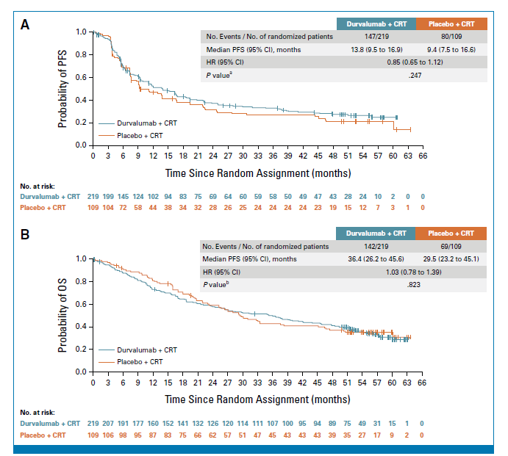
Example of combination failure.
Bradley JD, et al.
Simultaneous Durvalumab and Platinum-Based Chemoradiotherapy in Unresectable Stage III Non–Small Cell Lung Cancer: The Phase III PACIFIC-2 Study. ASCO J 43: 3610-3621

Slide 34
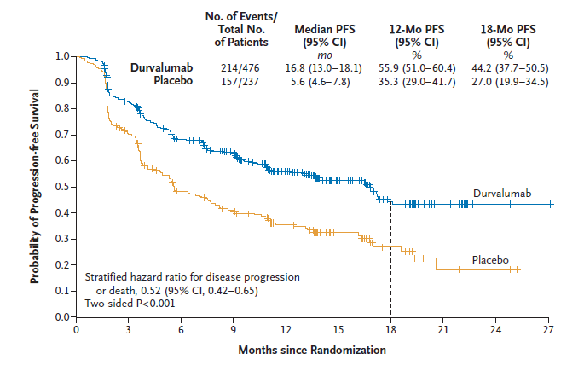
Example of successful combination.
Antonia S.J. et al.
Durvalumab after Chemoradiotherapy in Stage III Non–Small-Cell Lung Cancer
N Engl J Med 2017;377:1919-29.

Slide 35
How pharmacometrics can come to the rescue?
Trial‑and‑error timing optimization is inefficient and risky
Pharmacometrics models can:
Simulate thousands of dose levels and schedules of administration
Identify optimal sequencing windows before clinical testing
Quantify synergy/antagonism as function of time

Slide 36
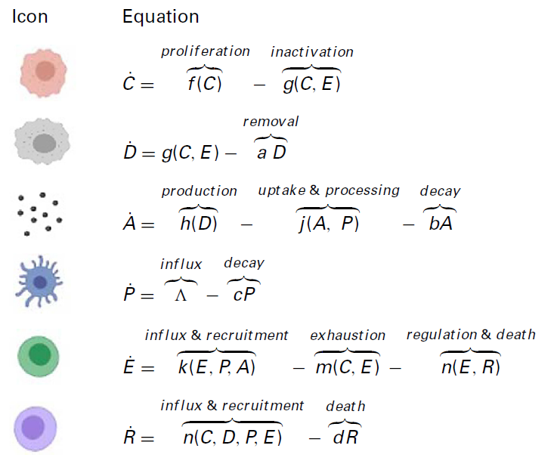
The field of Mathematical Oncology.
Cancer cells
Dying cancer cells
TTA
Antigen presenting cells
Effecor cells
Regulatory cells
Becker R.A., et al. Mathematical modeling of radiotherapy and its impact on tumor interactions with the immune system. Neoplasia 2022, 28 pp. 100796

Slide 37
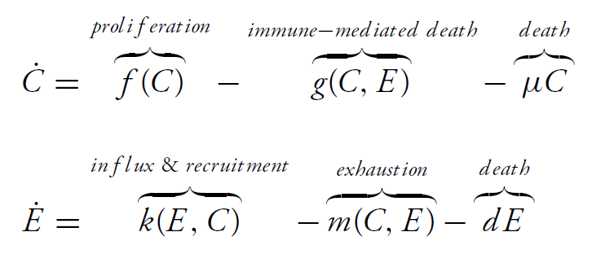
The field of Mathematical Oncology.
Predator-prey or Lotka-Volterra type mathematical model
Becker R.A., et al. Mathematical modeling of radiotherapy and its impact on tumor interactions with the immune system. Neoplasia 2022, 28 pp. 100796

Slide 38
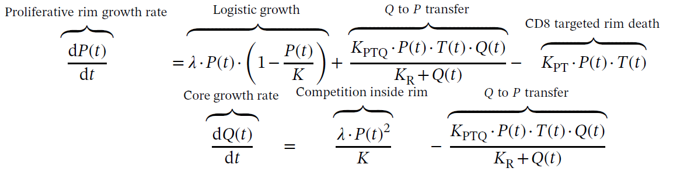
The field of Mathematical Oncology.
Subcutaneous injection of the murine colorectal cancer cell line MC38, in female C57/BL6 mice
Hodson D., et al. Mixed effects modeling of radiotherapy in combination with immune checkpoint blockade or inhibitors of the DNA damage response pathway. CPT Pharmacometrics Syst Pharmacol. 2023;12:1640–1652

Slide 39
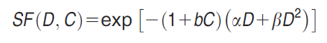
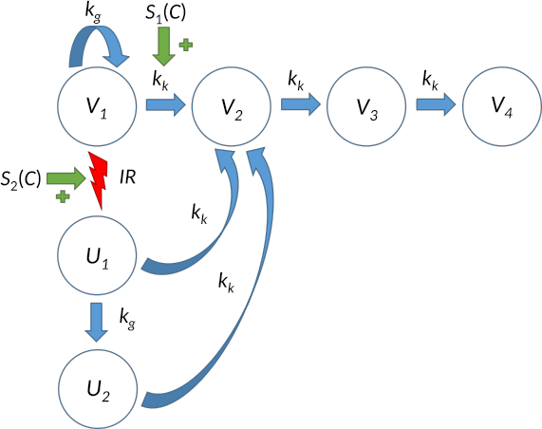
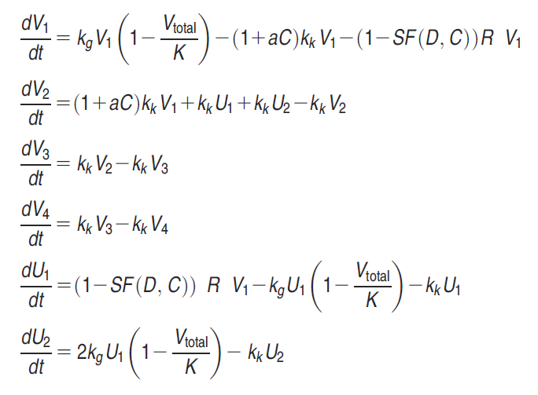
The field of Mathematical Oncology.
Cardilin T, et al. Model-Based Evaluation of Radiation and Radiosensitizing Agents in Oncology. CPT Pharmacometrics Syst. Pharmacol: 2018, 7, 51-58

Slide 40
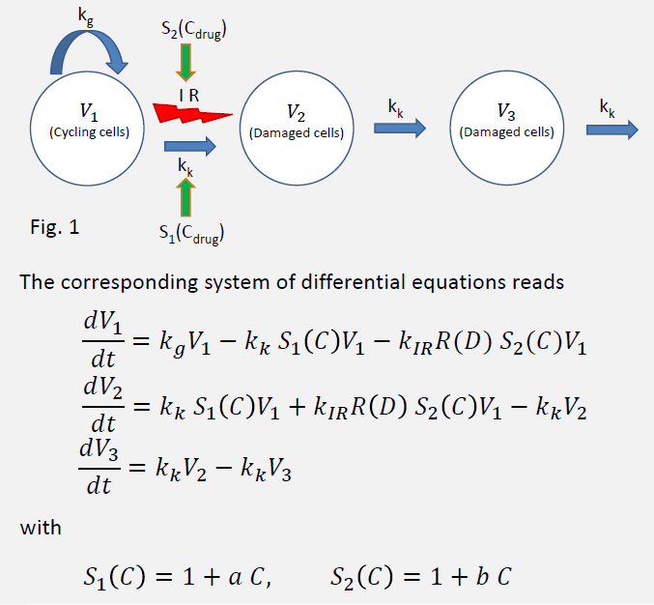
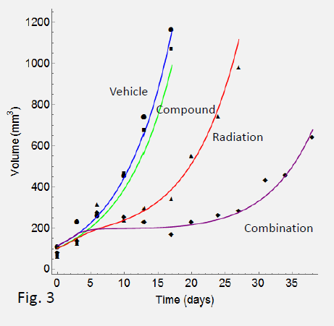
The field of Mathematical Oncology.
Cardilin T., et al. Extending tumor static concentration curve to average doce – conbination therapy example using radiation therapy. 2016 PAGE (Population Approach Group in Europe) Lisbon, Portugal

Slide 41
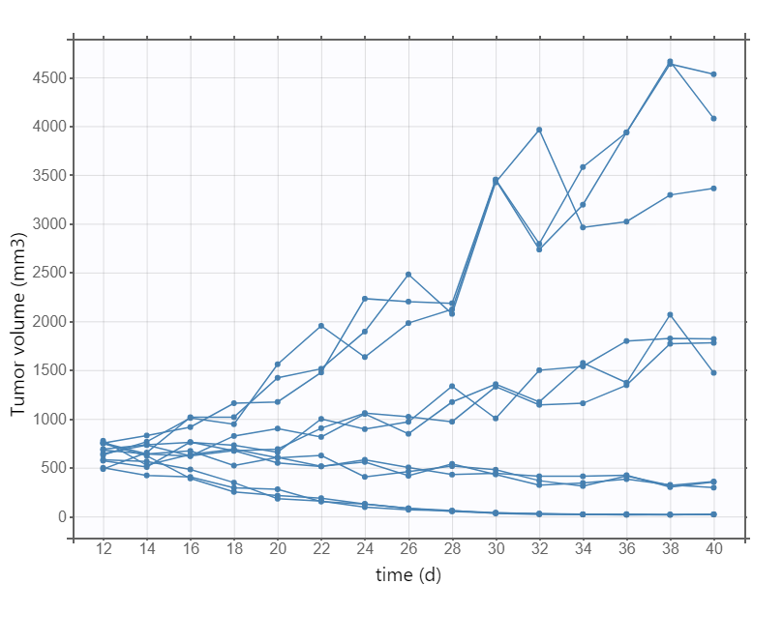
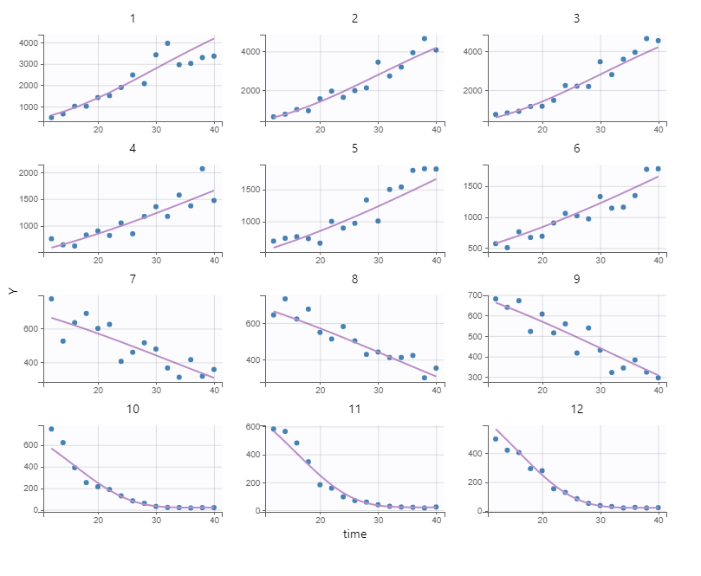
Application to tumor growth inhibition models. The case of radiosensitizers.
Gompertzian models in tumor growth and tumor growth inhibition analysis.
$$V_{(t)}={Tv}_{min}+\left({Tv}_{max}−{Tv}_{min}\right)∗e^{{−e}^{−kg∗\left(t−Ti\right)}}$$
Tjorve KMC, Tjorve E. The use of Gompertz models in growth analysis, and new Gompertz model approach: an addition to the unified Richards family. PLoS ONE 2017, https://doi.org/10.1371/journal.pone.0178691

Slide 42
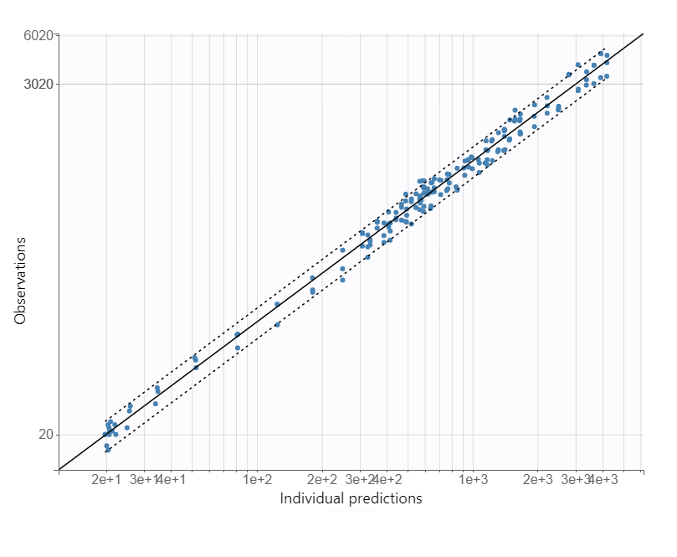
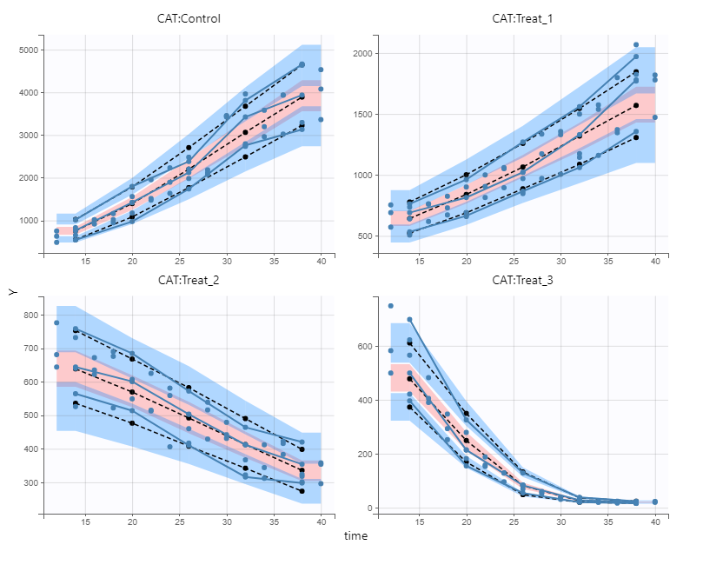
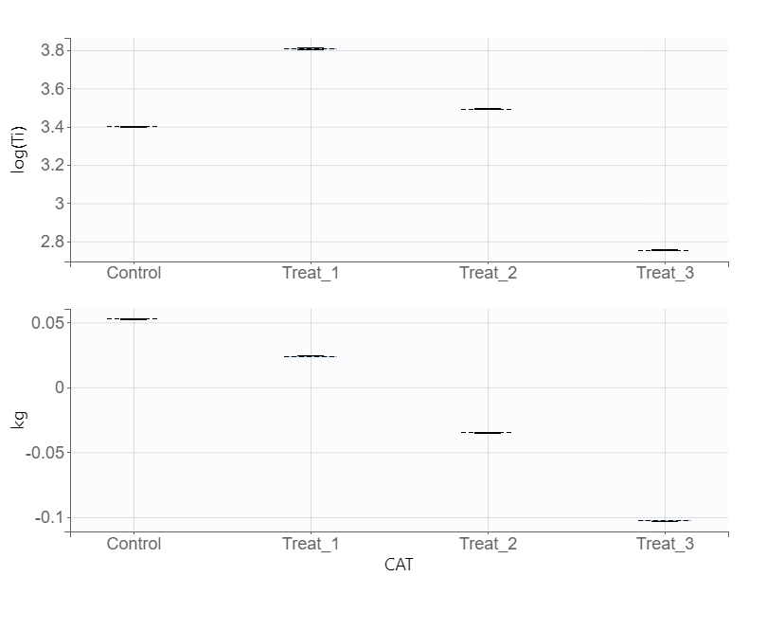
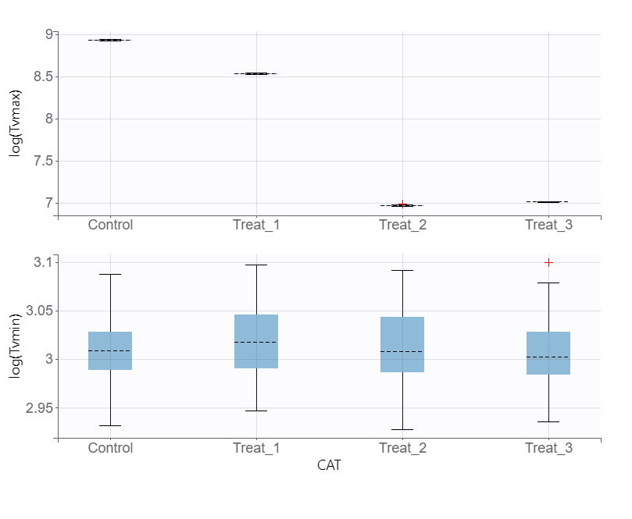
Application to tumor growth inhibition models. The case of radiosensitizers.

Slide 43
Application to tumor growth inhibition models. The case of radiosensitizers.
Data from: Zamulaeva I A, et al. Radiobiological effects the combined action of 1-β-D-arabinofuranosylcytosine and proton radiation on B16 melanoma in vivo. Physics of Particles and Nuclei Letters; 2023, 20, 63-75

Slide 44
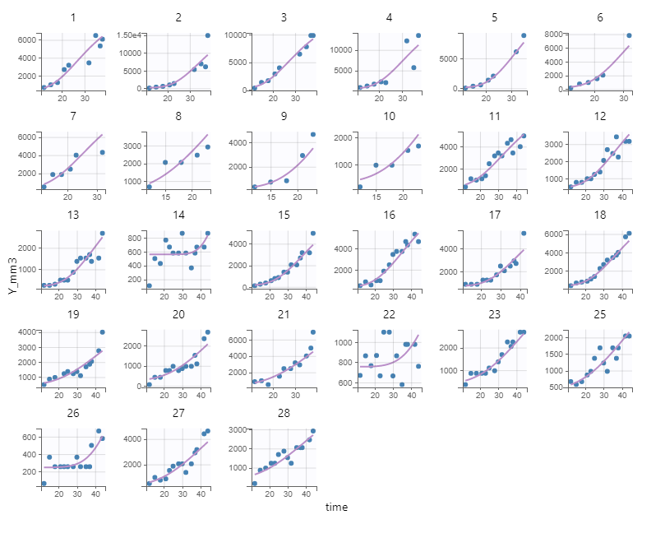
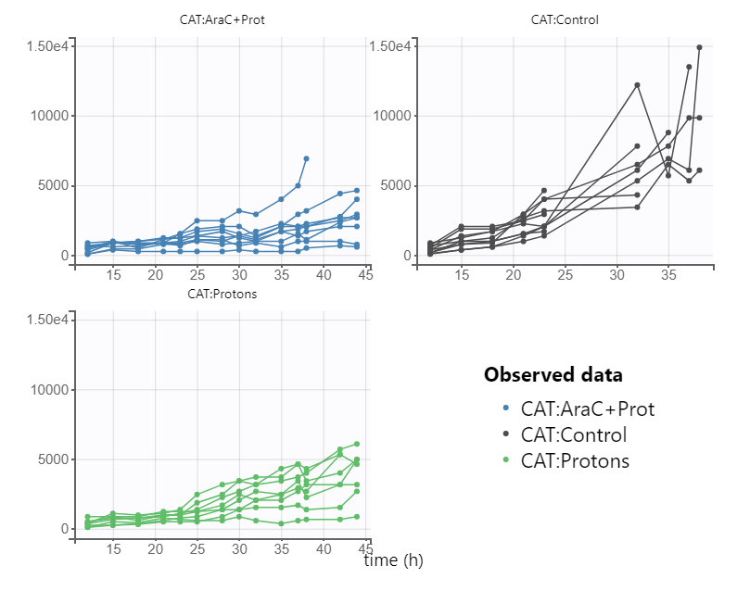
Application to tumor growth inhibition models. The case of radiosensitizers.
Fitting to the described Gompertz model:

Slide 45
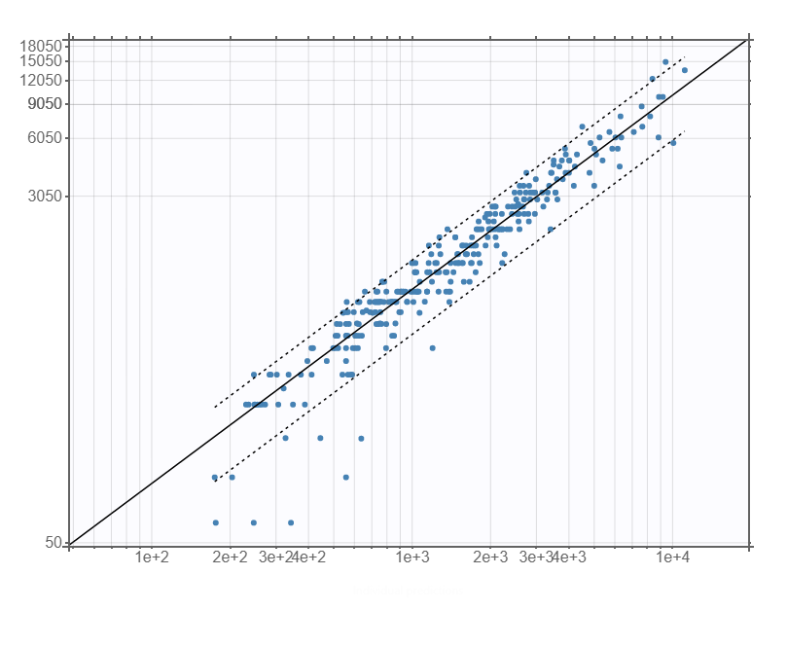
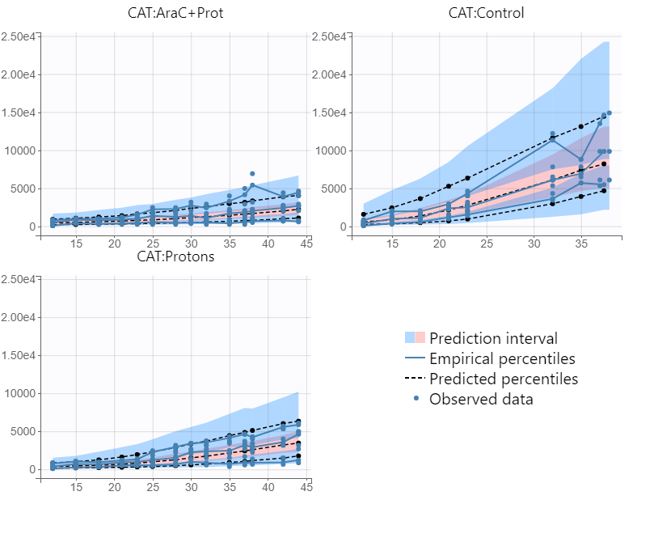
Application to tumor growth inhibition models. The case of radiosensitizers.
Fitting to the described Gompertz model:

Slide 46
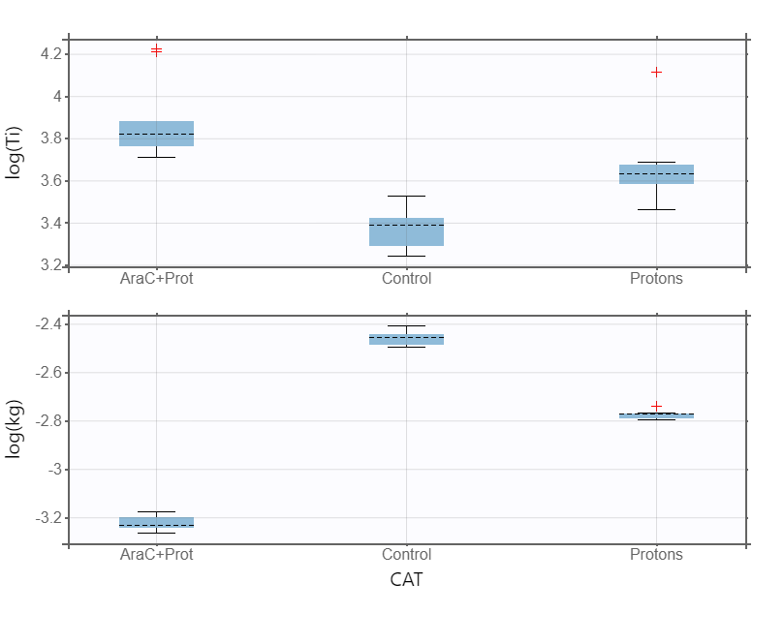
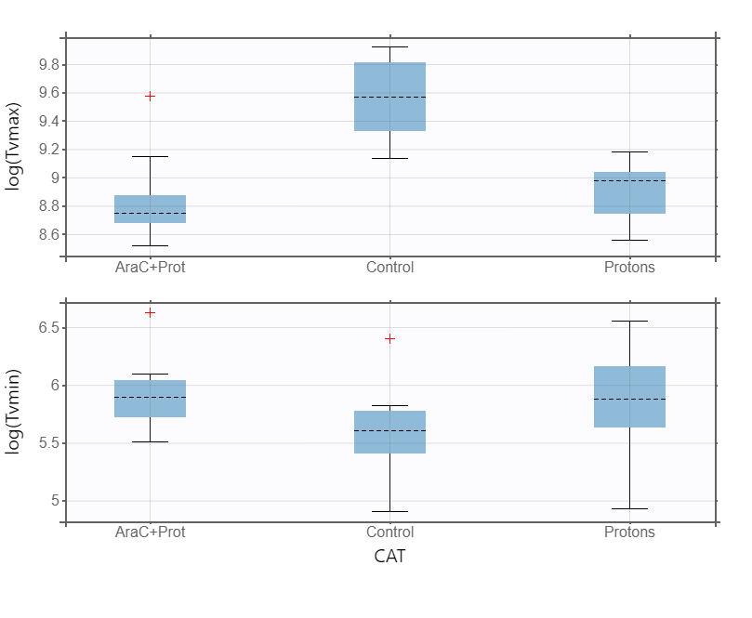
Application to tumor growth inhibition models. The case of radiosensitizers.
Fitting to the described Gompertz model:

Slide 47
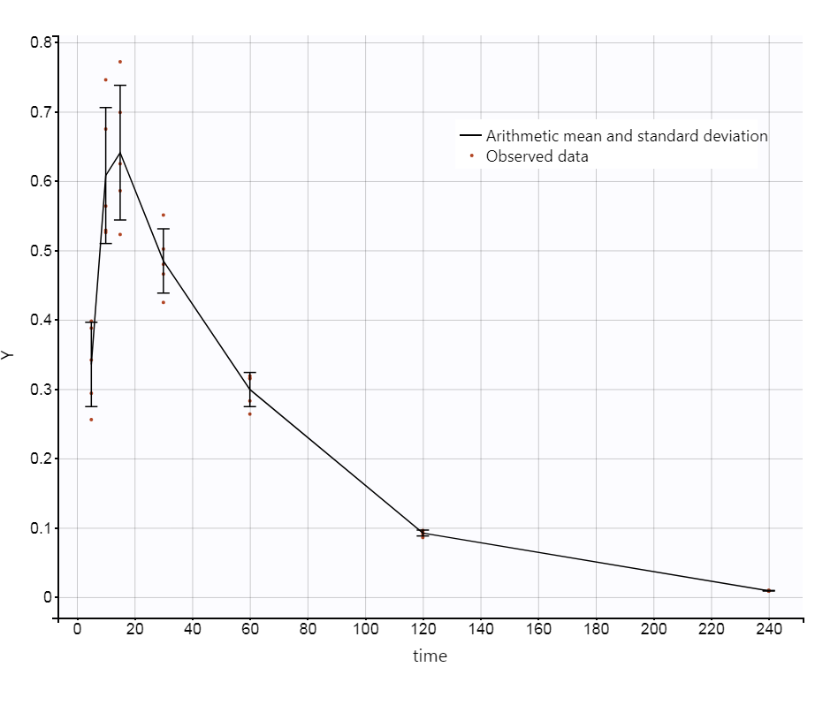
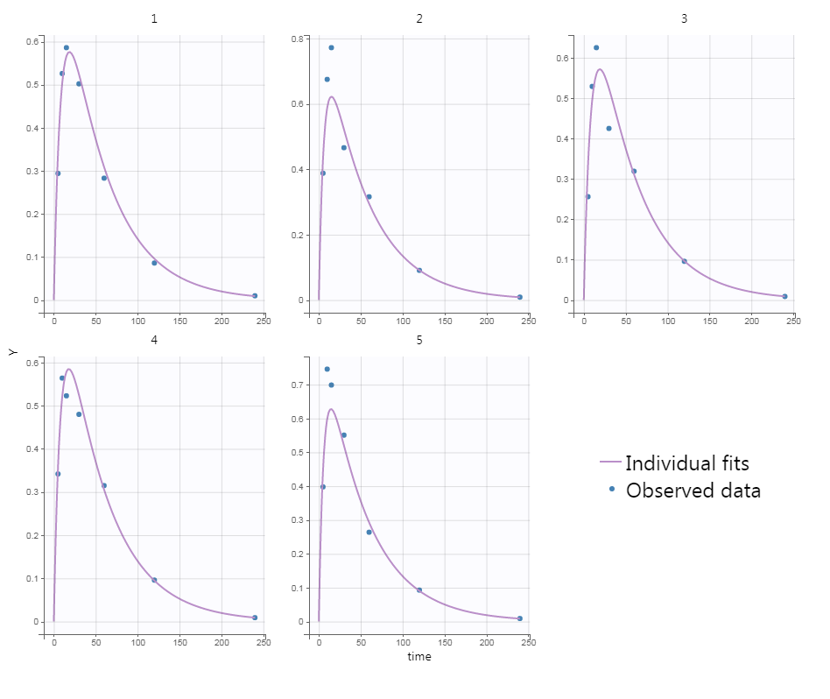
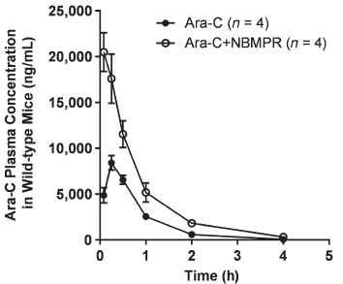
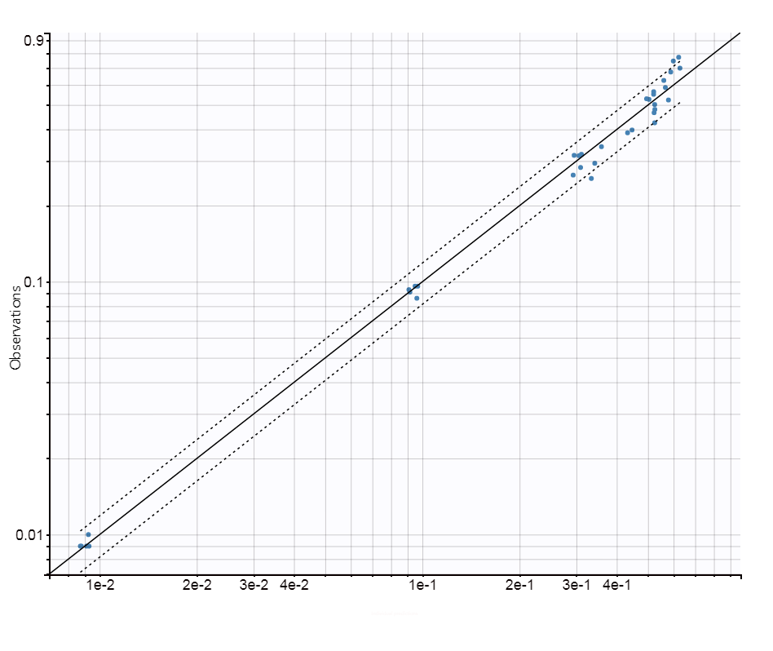
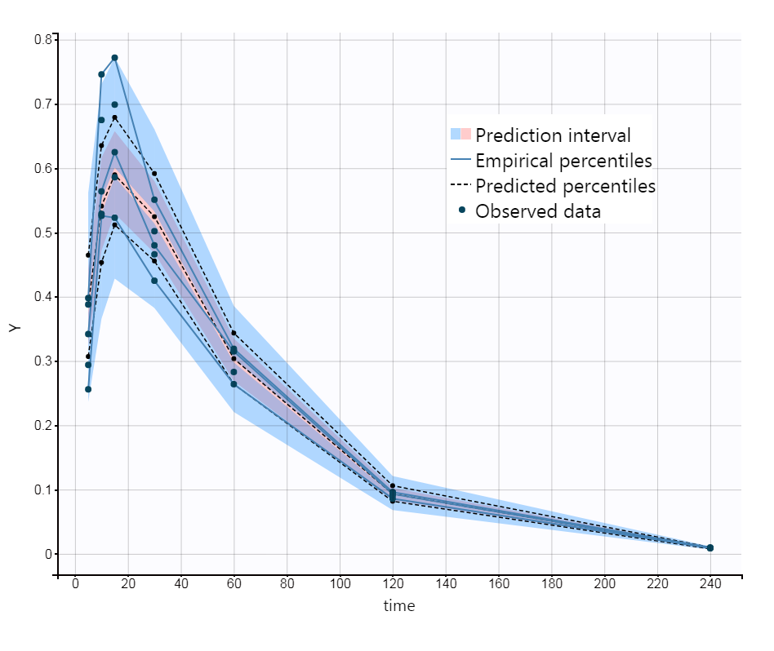
Pharmacokinetic for experimental design obtimizatio. The case of radiosensitizers.
mg/mL
mg/mL
Time (min)
Time (min)
Anderson Our PK
Dose: 15 mg/kg 100 mg/kg
T_{1/2}: 0.44 h 0.60 h
T_{max}: 15 minutes 15 minutes
Concentration: ng/mL mg/mL
Observed values
mg/mL
Predicted values
Time (min)

Slide 48
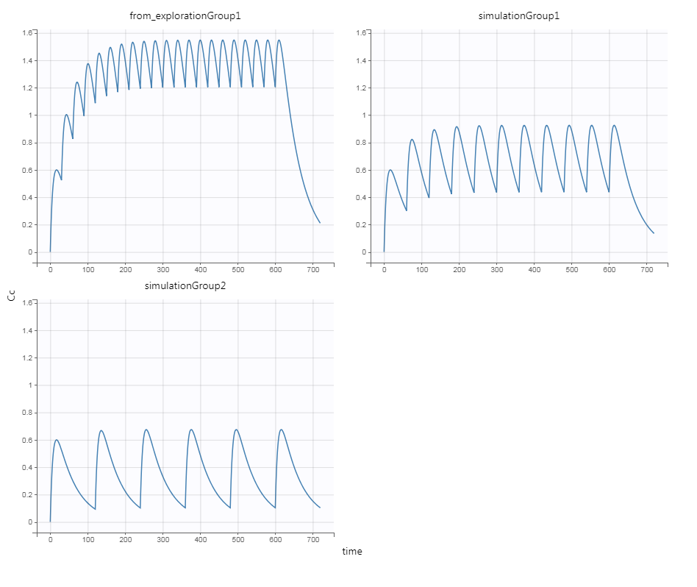
Pharmacokinetic for experimental design obtimizatio. The case of radiosensitizers.
Repeated administration
100 mg/kg
Every 30, 60 & 120 minutes
mg/mL
mg/mL
Every 60 minutes
Every 30 minutes
Different administration interval
mg/mL
Every 120 minutes
Time (min)

Slide 49
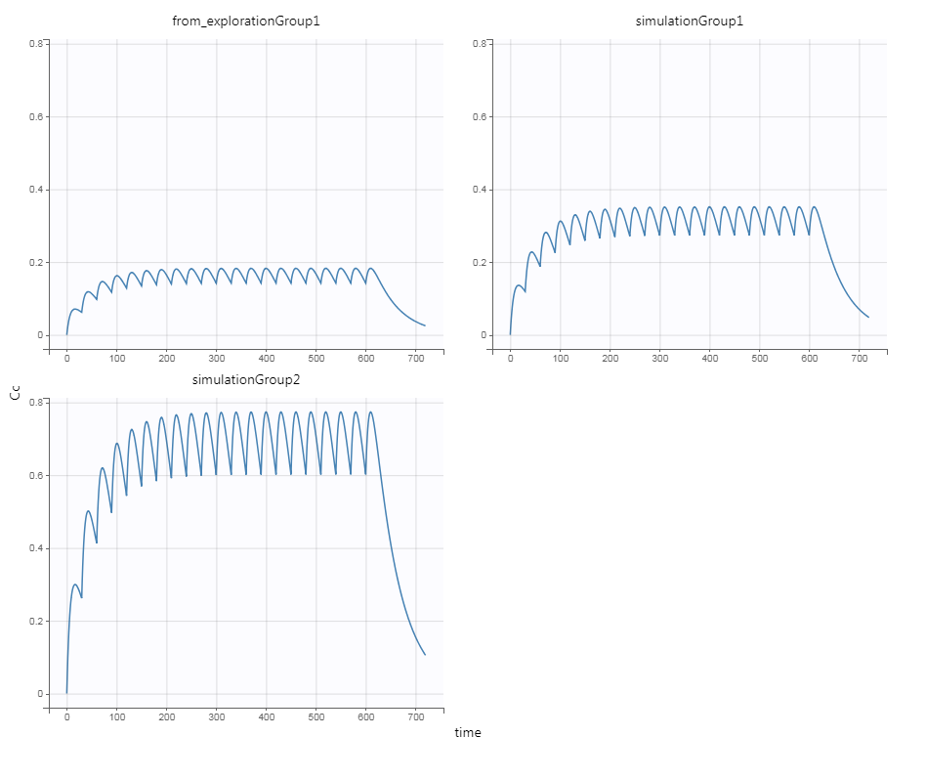

Pharmacokinetic for experimental design obtimizatio. The case of radiosensitizers.
Repeated administration
Every 30 minutes
mg/mL
mg/mL
23 mg/kg
12 mg/kg
Different doce
12, 23 & 50 mg/kg
mg/mL
Assuming that pharmacokinetic parameters do not change with dose.
50 mg/kg
Simulx
Monolix Suite version 2022R2, Lixoft, France
Time (min)

Slide 50
Conclusions:
We need to work a lot
Thanks very much

